Slide 1
Saving Homes in Bankruptcy
Attorney Nick C Thompson
Louisville KY 40223
800 Stone Creek Parkway Suite 6
Louisville KY 40223
502-429-0057
Bankruptcy@Bankruptcy-Divorce.com
www.Bankruptcy-Divorce.com

Slide 2
Foreclosoure Facts:
Normally 1out of every 200 homes will be foreclosed upon. For a city like Washington, D.C., that translates to 3,000 Washingtonians losing their homes to foreclosure each year.
Every three months, 250,000 new families enter into foreclosure. One child in every classroom in America is at risk of losing his/her home because their parents are unable to pay their mortgage.
- Information from Mortgage Bankers Association

Slide 3
Factors that cause Foreclosoure:
32% experience a job loss
25% experience a health crisis
85% have already missed one mortgage payment
50% have already missed two payments
Most have no savings, no available credit, and their extended families have limited resources.
Most have first-time loans, and most loans are less than three years old.
They may have already refinanced two or three times.
– Homeownership Preservation Foundation data of 60,000 homeowners

Slide 4
Foreclosoure doesn’t just cost the homeowner:
Prime Lenders and investors often lose from 20 cents to 60 cents on the dollar. Lenders typically lose $50,000 or more on one foreclosure. But low- and moderate-income borrowers who enter a repayment plan are 68% less likely to lose their homes. – Dona Dezube, “Heroic Homeownership,” Mortgage Banking, (June 2006) p. 82.
Subprime loans and rescue scams are designed to make money from foreclosures. A foreclosure results in as much as an additional $220,000 in reduced property value and home equity for nearby homes. “Collateral Damage: The Municipal Impact of Today’s Mortgage Foreclosure Boom,” May 11, 2005, p. 4.

Slide 5
Attorneys advise the Homeowner and Counsel on
Whether to file or seek other methods
Choosing the type of bankruptcy
Timing considerations
Seeking alternatives to bankruptcy
Unsecured creditors are normally paid only a percentage of their debt. Attorney fees often only means that a lower percentage is paid to unsecured.

Slide 6
When the foreclosure is filed.
When the foreclosure is filed the debtor only has 20 days to answer the complaint or they lose by default and the home may be sold within 21 days after the commissioner starts the advertisment for sale.
Debtors should consider whether they should catch up the payments by filing a Chapter 13 in Federal court or delay the foreclosure by answering the complaint in state court

Slide 7
Alternatives to bankruptcy
A mortgage restructure or modification may be offered this normally only reduces the interest or monthly payment and rarely reduces principle owed for the home.
A short sale allows the mortgage company to take immediate possession and the homeowner immediately loses the property and becomes liable for the deficency or any income from the debt that is forgiven.
A deed in lieu offers the same consequences as a short sale.

Slide 8
Debtors should not attempt to be lawyers
Debtors are not attorneys but work with their attorneys to file a Chapter 7 or 13. Clients are primarily required to educate themselves about the process and follow Court Orders Orders from the court include:
The duty to provide documentation.
Supply an annual budget in most districts.
In most districts income tax refunds are placed into the plan.

Slide 9
The Benefits of Bankruptcy
Bankruptcy Stays (stops) foreclosure proceedings
Decelerate loans and can cure defaults
Can modify some home loans (Primarily Seconds)
Venue for predatory lending claims
Avoid transfers in foreclosure rescue scams
Trustee in bankruptcy can be an advocate
Free up income by discharging unsecured debt
Can allow for payment of Priority debts (Taxes and Child support) at the expense of unsecured debt.

Slide 10
Timing Factors
Pending foreclosure
Debtor must act before the sale
Debtor may also wish to file an answer to any complaint
Costs of default mount if the Debtor delays
A prior bankruptcy may effect which chapter is filed
Obtain competent counsel early in the process
Pre-bankruptcy
Credit counseling required
You must provide documentation to support scheduled expenses especially high medical, and a history of expenses school tuition or 401k and church donations.

Slide 11
The Bankruptcy Automatic Stay
The Bankruptcy stay is a temporary court order in effect until the permanent stay court order is issued at the end
Prohibits most efforts to collect debt or enforce liens
Stops home foreclosures, whether judicial or non-judicial process up to moment of sale
Automatic, no need for injunction or posting of bond
There are 27 Exceptions to the Stay! Thankfully you don’t have to know them all.
Residential tenant evictions
Repeat bankruptcy filers must file motions at the start of case
Child Support Alimony and Domestic Matters
Criminal Restitution
Notes:
Commencement or continuation of judicial or other proceedings to collect pre-petition claims
Efforts to create, perfect or enforce liens on property of the estate or of the debtor, if relating to a pre-petition claim
Efforts to take possession of or assume control of property of the estate
Enforcement against the debtor or property of the estate of a pre-petition judgment
Any act to collect pre-petition claim
Setoff of pre-petition debts
Exceptions
Criminal actions or proceedings
Enforcement of domestic support obligations – property of the estate still protected in most instances
Perfection of liens that relate back to a time prior to the filing of the petition
Enforcement of police or regulatory powers – includes enforcement of judgments, except money judgments
Certain tax determinations and proceedings – audits, notices of deficiency, assessments
In rem orders
Automatic stay not applicable as to enforcement of real property lien if:
in rem order relating to property has been entered in a prior case, and
if order properly recorded, stay does not apply as to property in later case filed within two years after date of in rem order
filing of petition was part of scheme to hinder, delay, and defraud creditors and
scheme involved either:
transfer of full or partial interests in property without approval of secured creditor or bankruptcy court, or
multiple bankruptcy filings involving the same property
Courts may consider the “intent to hinder, delay or defraud a creditor” language found in § 727(a)(2), but note conjunction “and”
Unauthorized transfer of property or multiple bankruptcy filings must be part of scheme
No in rem order if innocent transfer of property, such as court ordered transfer of property to debtor in domestic court proceeding
“Multiple” means in rem order should not be entered in first case involving property
Section 362(d)(4) does not limit scope of in rem order to secured creditor who moved for order or debtor in whose case it was entered
court should be free to place limitations on order’s scope
Debtor in later case may move for relief from in rem order based on changed circumstances or other good cause

Slide 12
Repeat Filings
PRIOR DISMISSED CASE WITHIN ONE YEAR OF FILING
Automatic stay expires 30 days after petition date in individual chapter 7, 11, or 13 case
Court may extend stay as to all or some creditors if motion must be filed before 30 days expires
Must demonstrate case filed in good faith with respect to creditors to be stayed
Debtor may need to rebut presumption of bad faith
TWO OR MORE CASES DISMISSED WITHIN ONE YEAR OF FILING
Automatic stay does not go into effect upon filing
Notes:
unless compelling reason to file joint case, may be advisable for one spouse of debtor couple to file individual case, especially if chapter 13 case filed to cure a default on joint mortgage
does not prevent co-debtor stay from arising if prior dismissed case was a joint case and second case was filed by only one spouse

Slide 13
Exemptions
The Bankruptcy Estate is that property that you own at the time of filing, plus any property you transferred for less than it’s value prior to filing and property you may inherit within 6 months after.
Property Exempted from the Estate
Exemptions don’t protect against foreclosure of mortgage (Exemptions may allow you to avoid a judgment lien but statutory liens such as tax liens can only be valued and not avoided.

Slide 14
Kentucky uses the Federal Exemptions
The homestead exemption is limited in Kentucky to approximately 23,000 dollars per person on the residential Deed. Married couple both on the Deed would have about 46,000 allowed in equity. This amount increases annually. The exemption may be used for other property but then it decreases by ½ to 11,500.
Other exemptions exist for other property.
Kentucky and the Federal exemptions have constant cost of living increases.

Slide 15
Modifying Mortgages in Chapter 13
Currently a Bankruptcy may not modify long term residential first mortgages: §1322(c). However residential second mortgage that has no equity may be eliminated by 522(f) motions to strip the mortgage and language in a Chapter 13 plan
No “cramdown” or “strip down” of principal
No change in interest rate
No extension of term
May not require a lien be released unless the claim is paid in full or until discharge under: §1325(a)(5)

Slide 16
Modifying Mortgages in Chapter 13
Although a Bankruptcy may not modify long term residential first mortgages a Chapter 13 can modify a:
Short term residential mortgage
Commercial mortgage
Vacation home mortgage
Mortgage for a second home.
Loans that include personal property with security agreement. Ex mortgage for trailer and lot.

Slide 17
Language necessary in a Plan
Currently a Bankruptcy plan may include language in a plan to strip a lien. An example of a plan provision is attached as a file link to our website.
Some jurisdictions have allowed a 522(f) motion to also strip a second mortgage when a home lacks any equity for the second mortgage to attach to.
Attorneys may wish to use both methods to eliminate a second mortgage.
Judicial liens can be removed if they impair the exemptions. Income tax liens are stautory liens and cannot be removed with these methods see the section on income tax lien removal for income tax liens. www.Bankruptcy-Divorce.com

Slide 18
Mortgage Claims in Chapter 13
Creditor files proof of claim (the amount of debt), including any arrears
The Debtor must pay allowed secured claims in equal monthly payments in an amount to adequately protect claimant during the plan: §1325(a)(5)(B)
Claims should always be reviewed because some mortgage companies will inflate foreclosure and other charges or expenses.

Slide 19
Curing Mortgage Arrears
Arrears include pre-bankruptcy
missed payments,
default costs, and
foreclosure expenses
“Reasonable” time for cure usually length of Chapter 13 plan (3-5 years)
Arrears payments made to Trustee but monthly mortgage, insurance and property taxes payments are paid directly to the mortgage company beginning the month the case is filed.

Slide 20
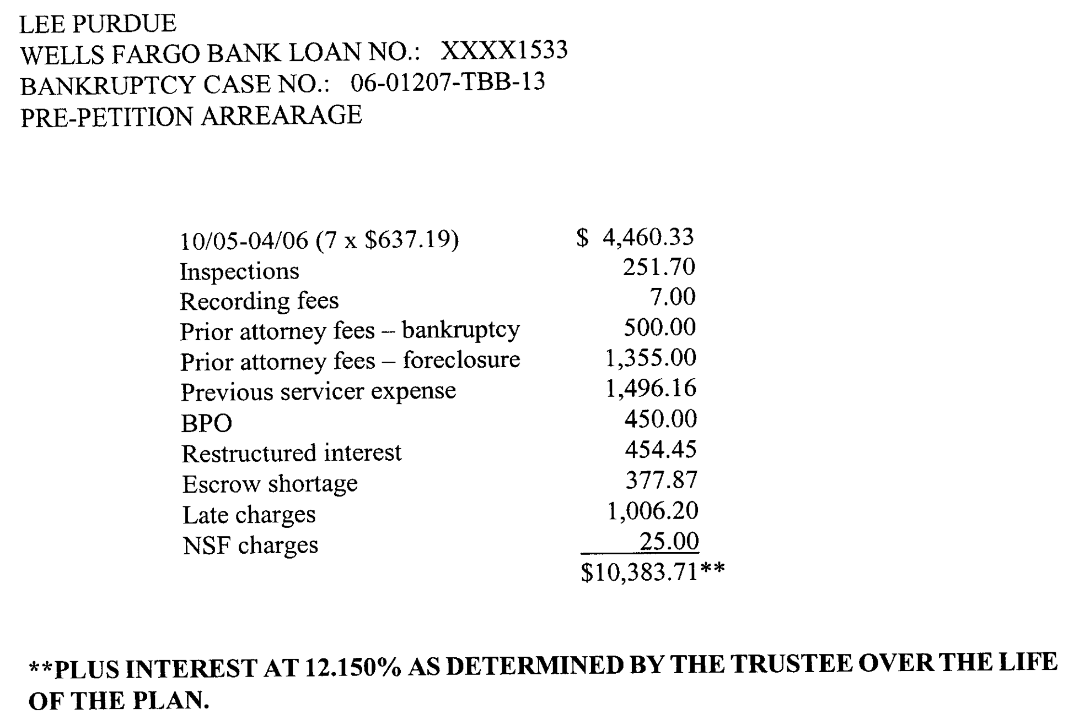
How to Challenge Inflated Claims The Drive by Inspection

Slide 21
Review Your Claims for pre and post filing expenses

Slide 22
Challenging Inflated Claims

Slide 23
Challenging Inflated Claims

Slide 24
Challenging Inflated Claims

Slide 25
Challenging Inflated Claims
Fixed rate note, P&I payment: $468.08; Late Fee = 5% of P&I = $23.40; Assessed Late Fees - 43

Slide 26
How to Strip Down or Cramdown a Second Mortgage
•Mortgage or liens may be partially secured and partially unsecured Bifurcation of claims under § 506
Secured to value of collateral
Unsecured (pro rata payment)
• Exception: Claims secured only by real property that is the debtor’s principal residence
§1322(b)(2)
Nobleman v. Am. Savings Bank, 508 U.S. 324 (1993)

Slide 27
Modification - Strip Down
The Debtor’s Principal Residence this includes a mobile home.
General definition in Bankruptcy Code includes mobile home: § 101(13A)
§ 1322(b)(2) still refers only to real property
Loans on mobile homes that are personal property under state law may be stripped down

Slide 28
Modification - Strip Off
Stripping of an “Underwater Mortgages”
• Typically 2nd or 3rd mortgages
• Value of senior liens equals or exceeds property value
• Security interest is rendered void on completion of the plan
• Amount due to a 2nd mortgage is treated as unsecured in Ch.13 if there is no equity.
• Requires valuation obtain Property Valuation Assessment and any recent appraisal for a motion and/or provision of the Chapter 13 plan.

Slide 29
“Cramdown” legislation
Has been pending and under debate for years and is unlikely to pass
Unlikely due to Special Interest Campaign Contributions
Limited to subprimes, with sunset or time restrictions
Capacity of courts, trustees, bar to handle increased cases
4 kinds of “judicial modification”
Reduction in principal
Lowered interest rate—benchmark?
Freeze on interest rate changes
Reamortization up to 40 years
Costs/risks of filing bankruptcy

Slide 30
Predatory Practices subject to Bankruptcy Adversary, Motions
TIL, RESPA, HOEPA
Many claims look at what was done with payments and whether the plaintiff is secured.
Attack on foreclosure rescue scams involving transfer for no value
Escape from arbitration clauses
Faster and more consumer-oriented litigation process

Slide 31
Trustee duties in Bankruptcy
All cases: review schedules, file reports
Chapter 7: liquidate non-exempt assets
Chapter 13:
Review repayment plan
Collect plan payments
Direct v. Conduit Pay of Mortgages
Disburse to creditors
Point of contact for debtors

Slide 32
Success in Bankruptcy
Nationally, only 1 in 3 Chapter 13 cases ends in discharge due to continued financial problems or no need later in the plan for the discharge.
Is a discharge necessary for success or the right measure of success? Is conversion to a Chapter 7 or an early hardship discharge possible.
What predicts whether homeowner saves home?
Affordability predicts success —more than 70% of debtors continue to spend more than 30% of income (net wages + all other income).

Slide 33
Other Kentucky Resources
Don’t Borrow Trouble 1-866-830-7868 www.dontborrowtrouble.com
Louisville Metro Dial 2-1-1 www.louisvilleky.gov/foreclosure
Housing Partnership Inc. 333 Guthrie Green, Suite 404 Louisville, KY 40202 www.housingpartnershipinc.org 502-585-5451
Louisville Urban League 1535 W. BroadwayLouisville, KY 40203 502-561-6830 www.lul.org
Legal Aid Society 416 W. Muhammad Ali Blvd., Suite 300 Louisville, KY 40202 502-584-1254 1-800-292-1862 www.laslou.org
HUD-approved housing counselors to explore your options at 1-800-569-4287 or TDD 1-800-877-8339.

Slide 34
Saving Homes in Bankruptcy
Attorney Nick C Thompson
With credit for the original presentation to
Professor Katherine Porter
University of Iowa School of Law
800 Stone Creek Parkway Suite 6
Louisville KY 40223
502-429-0057
Bankruptcy@Bankruptcy-Divorce.com

